Slide 1

Sentiment Analysis on Indian Farmer’s Protest
CYBER SECURITY RESEARCH CENTER
PUNJAB ENGINEERING COLLEGE (DEEMED TO BE UNIVERSITY)
CHANDIGARH – 160012 (INDIA)
MAY 2022
Submitted by:
Ashish Upadhyay
(SID: 21212003)
Under the guidance and supervision of:
Dr. Amrita Dahiya

Slide 2
Outline
Introduction
Motivation
Literature Review
Research Gaps
Objectives
Methodology
Implementation
Use-case
Results
Conclusion
Future Work
References

Slide 3
Introduction
Sentiment Analysis
The process of computationally identifying and categorizing opinions from piece of text to determine whether the writer’s attitude towards a particular topic, product, organization or service is positive, negative or neutral. It comes under natural language processing.
It has variety of applications on fields such as brand evaluation, public health, social behaviors, movie market and political scenario.
Twitter is a leading platform where people tweet about various topics from daily life events to major incidents. The influence of this social media platform analysis has attracted attention of developers and researchers.
Sentiment analysis, also known as OPINION MINING RESEARCH comes under NLP(natural language processing). Twitter generated data comprising of various tweets is collected, processed, classified and analyzed to determine POLARITY and SUBJECTIVITY of tweets.
Notes:
Word Cloud is a pictorial representation of commonly used words ina particular dataset
<number>

Slide 4
Motivation
Accurate analysis help organizations gain much better results and growth accordingly.
Surveys are expensive, time consuming and inaccurate.
Unsocial event cause unrest in the society

Slide 5
Literature Review
S.No. | Year | Title | Accuracy of best model | Models used | Journal/Conference/Publisher | Inferences Drawn
1 | 2014 | Web scraping technologies in an API world | ---- | ---- | Oxford Academic | Visual Web Ripper, Newbie, Mozenda, ScreenScraper, etc. desktop based web scrapping tools are discussed.
2 | 2015 | Sentiments analysis of Twitter data using data mining | Random forest-99..24% | Naive bayes, KNN, Randomforest, | IEEE | Data mining classifiers is a good choice for sentiments prediction using twitter data
3 | 2015 | Performance analysis of Ensemble methods on Twitter sentiment analysis using NLP techniques | Random forest-91% | Random forest, Decision tree | IEEE | Prediction accuracy is increased using Disambiguation and WordNet Extremely Randomized Trees classification has most accurate performance
Notes:
Classifiers Of Machine Learning:
Decision Trees
Bayesian Classifiers
Neural Networks
K-Nearest Neighbour
Support Vector Machines
WordNet is a lexical database of semantic relations between words in more than 200 languages.
2nd one- knn random forest ,bays, naivebays
<number>

Slide 6
Literature Review
S.No. | Year | Title | Accuracy of best model | Models used | Journal/Conference/Publisher | Inferences Drawn
4 | 2018 | Analysis of News in the Hindustan Times and India Today | ----- | ---- | Researchgate | News percentage is higher in Hindustan times than India today in form of e-papers Political news was found to be very dominating in Hindustan times over the scientific and other news
5 | 2021 | Visualization of Twitter Sentiments on Kashmir Territorial Conflict | NRC lexicon-87.6% | NRC,Vader,MNB, Decision tree, KNN | Cybernetics And Systems: An International Journal | Location-based data collection has been done by extracting 60k tweets The period of tweets collection is an important factor, which may affect the results strongly
6 | 2022 | Automated Detection of Anti-National Textual Response to Terroristic Events on Online Media | HE-CM-Bert 82% | SVM, CNN, Lstm, Bi-LSTM, HE-CM-BERT | Cybernetics And Systems: An International Journal | Vocabulary of pre-trained multilingual BERT is extended Anti-national code-mix textual content on YouTube in the form of comments on terrorism-related videos are used at dataset.
Notes:
Classifiers Of Machine Learning:
Decision Trees
Bayesian Classifiers
Neural Networks
K-Nearest Neighbour
Support Vector Machines
<number>

Slide 7
Research Gaps
Lack of dataset on farmer protest.
Lack of DECISION SUPPORT TOOL for government regarding farmer protest.
Notes:
<number>

Slide 8
Objectives
To create a diverse dataset based on farmer’s protest from multiple sources.
To understand the sentiments of the Indian citizens towards the three acts passed by the government.
To analyse the polarity and factuality of Twitter data regarding the demonstrations by extracting twitter data.
Notes:
Polarity is float which lies in the range of [-1,1] where 1 means positive statement and -1 means a negative statement. Subjective sentences generally refer to personal opinion, emotion or judgment whereas objective refers to factual information.
The subjec-tivity of data ranges from 0 to 1, with 0 being a complete opinion and1 being a fact
<number>

Slide 9
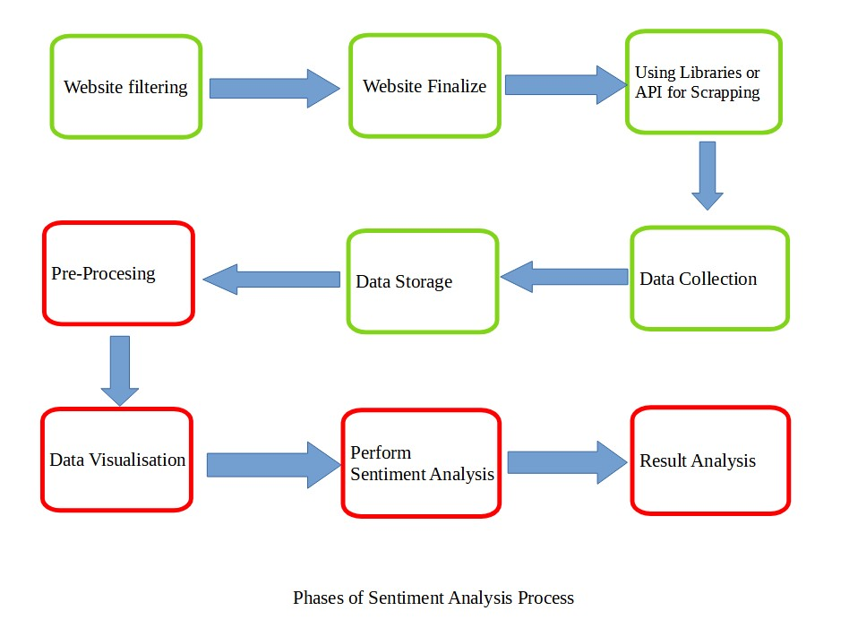
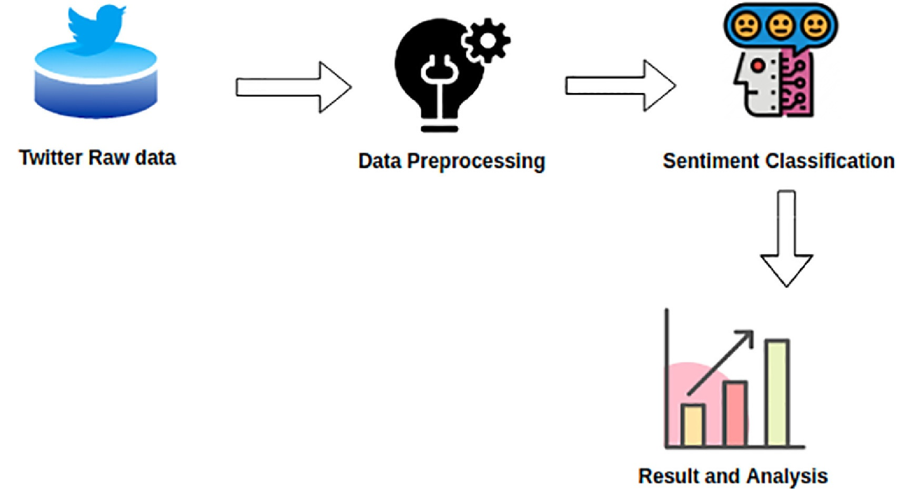
Proposed Methodology
Notes:
Data visualisation using classifier(KNN Random forest Naive bayes
<number>

Slide 10
Methodology
Library Used: SNSCrape, Pandas, datetime, TextBlob, WordCloud
API used: ParseHub
Index Term: “Farmer Protest”,
Data sources:
https://twitter.com/
https://www.hindustantimes.com/
Technologies Used: Python on google collab and Jupyter IDE

Slide 11
Implementation
Data Collection
Web Scraping - It is an automatic method to obtain large amounts of data from websites. Most of this data is unstructured data in an HTML format which is then converted into structured data in a spreadsheet or a dataset so that it can be used in various applications
Libraries tested in implementations are:
1.SNSCrape
2.ParseHub

Slide 12
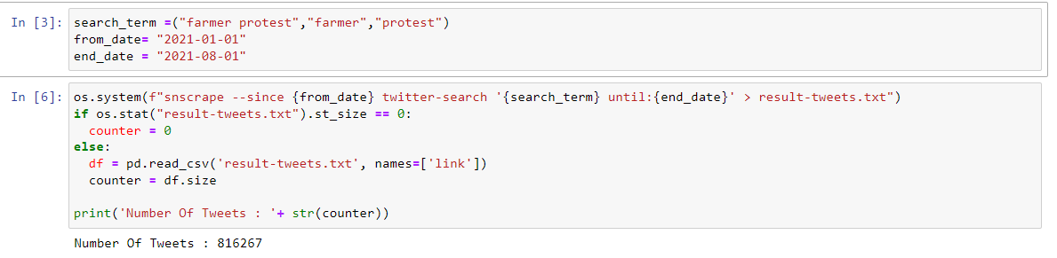
Implementation
SNScrape- it is a Library built for the scrapping purpose of twitter, Instagram, Redit, Telegram etc
By using this library tweets, caption, user-id, urls can be extracted
SNSCrape Syntax
Notes:
<number>

Slide 13
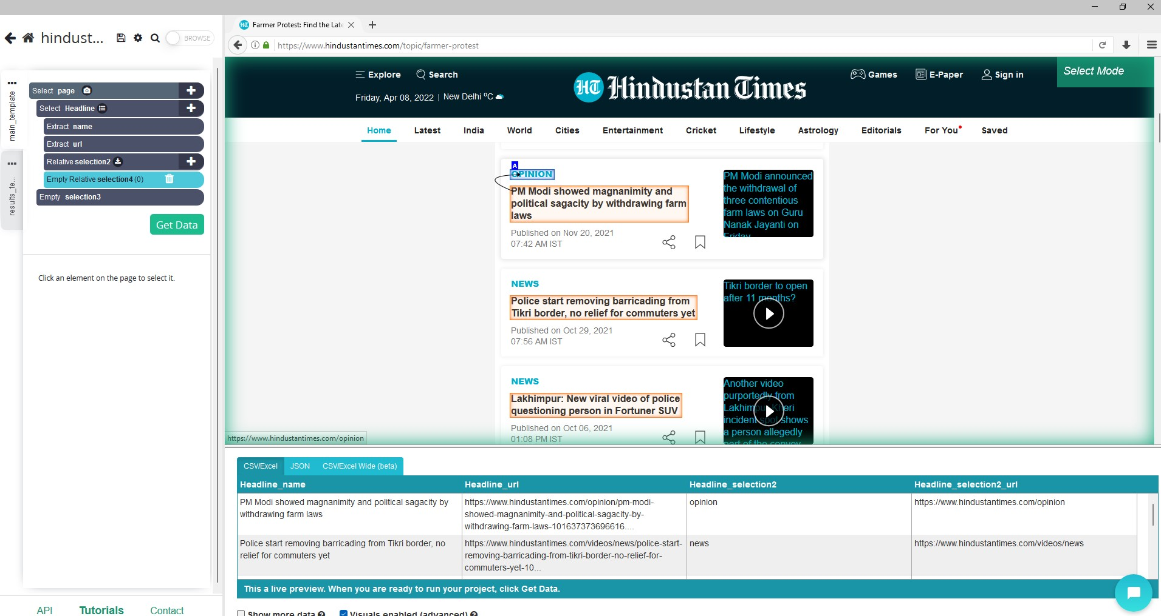
Implementation
Parsehub
No coding required
Free and powerful web scraping tool
Converts website into hierarchy of elements
ParseHub implementation and GUI

Slide 14
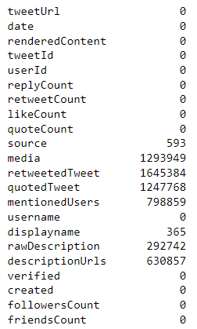
Implementation
Data Cleaning
The pre-processing of tweets like removal of stop words, repeated characters, special symbols pos-tagging, stemming execution can be referred to as Data-Cleaning.
Data cleaning

Slide 15
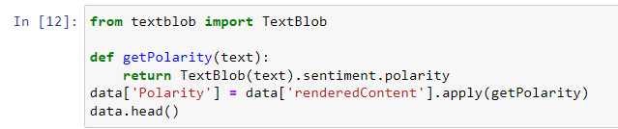
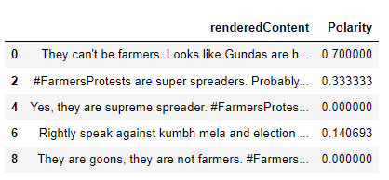
Implementation
Calculating Polarity
When a sentence is passed into Textblob it gives polarity count.
Polarity is the output that lies between [-1,1], where -1 refers to negative sentiment and +1 refers to positive sentiment.
Screenshot of polarity code
Polarity count

Slide 16
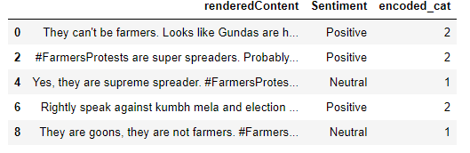
Implementation
The polarity is converted to sentiment tag
Sentiment tag is encoded to numeric value
Negative being 0
Neutral being 1
Positive being 2
Sentiment and encoded value

Slide 17
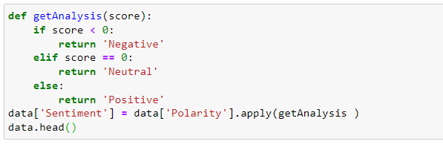
Implementation
Sentiment analysis performed
The code for sentiment analysis after obtaining the polarity of tweets
Screenshot of sentiment analysis on data-set

Slide 18
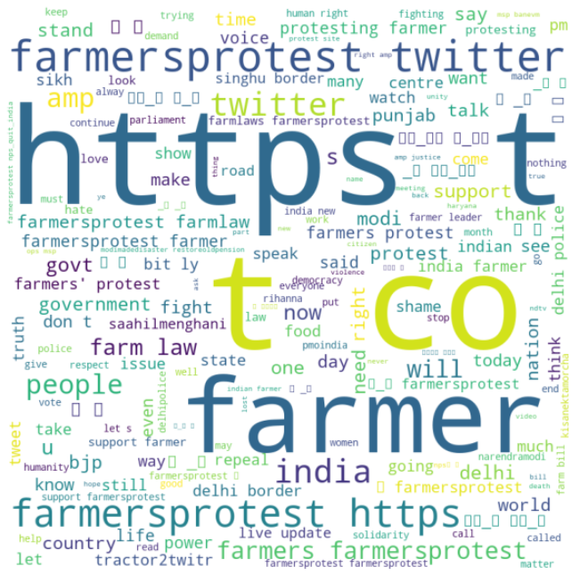
Implementation
Word Cloud
A word cloud (also known as a tag cloud) is a visual representation of words. Cloud creators are used to highlight popular words and phrases based on frequency and relevance. They provide you with quick and simple visual insights that can lead to more in-depth analyses.
WordCloud is created for the data set of tweet and Newspaper

Slide 19
Use case
This study might be valuable in the field of public policy, where governments may use machine learning techniques to improve decision-making and conduct mass behavioural analysis
The study can also be beneficial to analyse multiple protests happening internationally with a more inclusive approach to various local languages.
By using WordCloud data and polarity of statements, government could tackle protest even before they start.

Slide 20
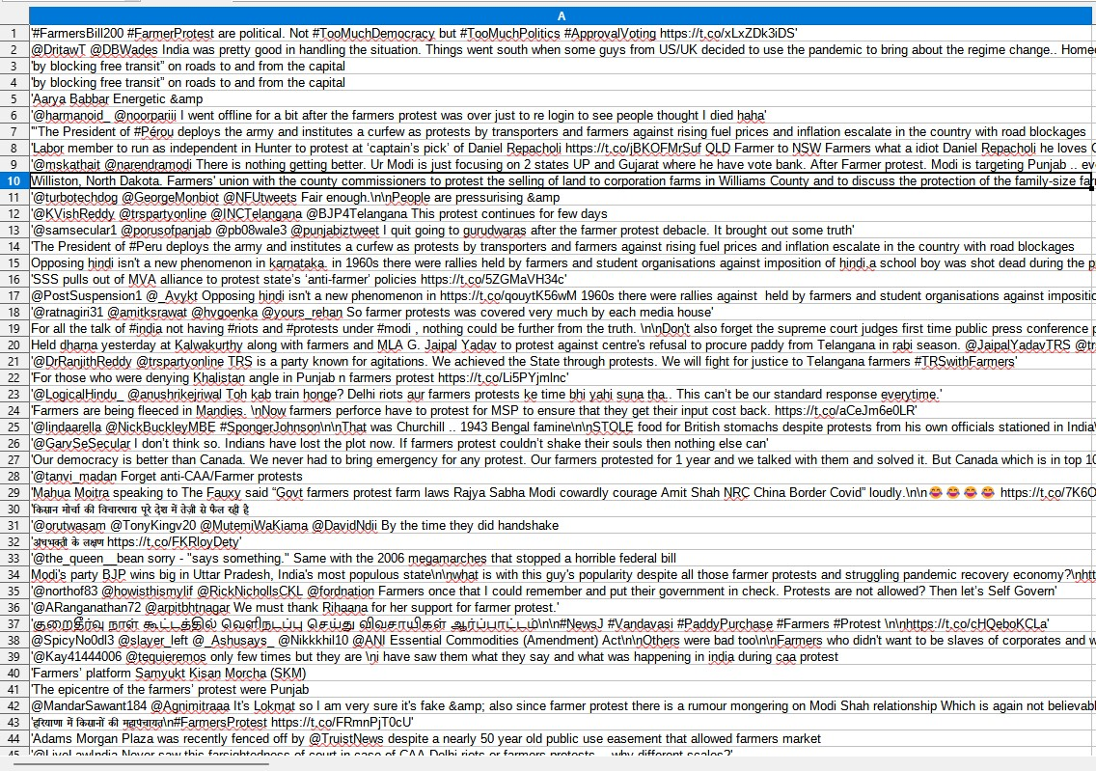
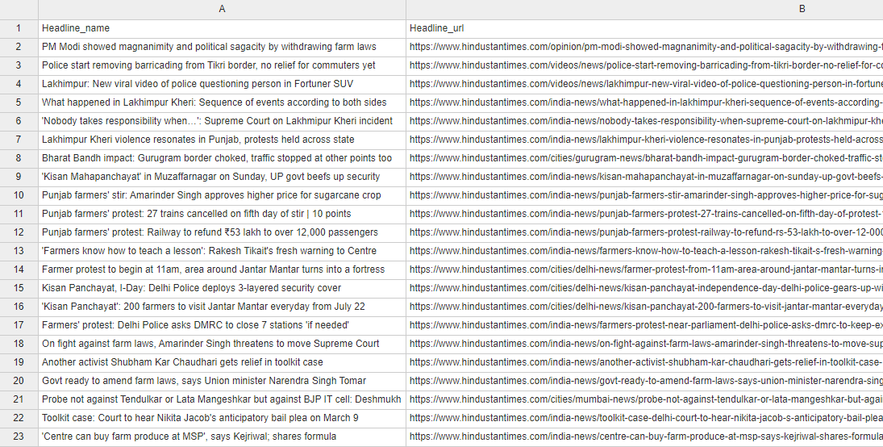
Results
Data is collected in form of tweets and headlines
Raw Tweets Extracted
Headlines Extraction by HindustanTimes
Notes:
<number>

Slide 21
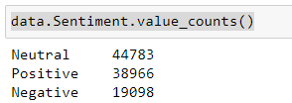
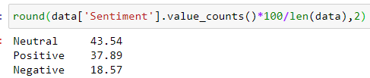
Results (Cont...)
Sentiment of collected dataset is calculated along with their polarity score
Result in numeric term
Result in percentage form

Slide 22
Conclusion
Data Collection :
In form of tweets
In form of News Headlines
In this project, we have explored ways to understand the sentimentality of people by building a sentiment analysis model and identifying the direction the protest is leading towards.
We discovered that the bulk of tweets are neutral, with positive sentiments coming in a close second and negative sentiments coming in last.

Slide 23
Future Work
Multilingual sentiment analysis can be implemented.
More lexicon based libraries can be explored to implement sentiment analysis.
Sentiment analysis can be implemented on unlabelled dataset.
Notes:
Sentiment analysis in a single language raises the danger of missing important information.
Our data is labelled
Vader nrc library
<number>

Slide 24
References
[1] | Glez-Peña, D., Lourenço, A., López-Fernández, H., Reboiro-Jato, M., & Fdez-Riverola, F. (2014). Web scraping technologies in an API world. Briefings in bioinformatics, 15(5), 788-797.
[2] | Jain, A. P., & Katkar, V. D. (2015, December). Sentiments analysis of Twitter data using data mining. In 2015 International Conference on Information Processing (ICIP) (pp. 807-810). IEEE.
[3] | Rajput, V., Ansari, I. A., & Pant, M. (2018). Analysis of News in the Hindustan Times and India Today. In Soft Computing Applications (pp. 45-58). Springer, Singapore.
[4] | Kanakaraj, M., & Guddeti, R. M. R. (2015, February). Performance analysis of Ensemble methods on Twitter sentiment analysis using NLP techniques. In Proceedings of the 2015 IEEE 9th international conference on semantic computing (IEEE ICSC 2015) (pp. 169-170). IEEE.
[5] | Rastogi, S., & Bansal, D. (2021). Visualization of Twitter Sentiments on Kashmir Territorial Conflict. Cybernetics and Systems, 52(8), 642-669.
[6] | Chaudhary, M., Vashistha, S., & Bansal, D. (2022). Automated Detection of Anti-National Textual Response to Terroristic Events on Online Media. Cybernetics and Systems, 1-14.

